Slide 1

Squash Game
UP
20800128 김윤태
20900132 김용진
20900194 김태이

Slide 2

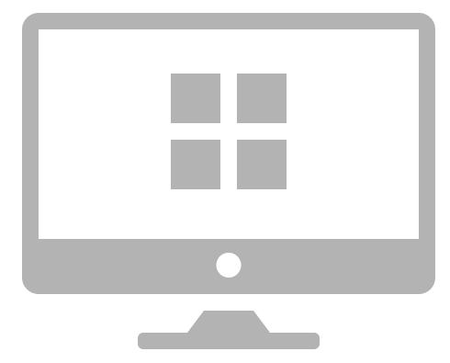
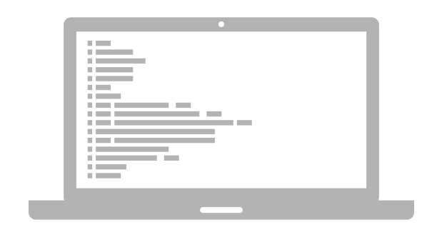
Contents
Squash Game
Code
Idea
Demo
Q&A

Slide 3
Squash Game
Q&A

Slide 4
Squash Game
Idea

Slide 5
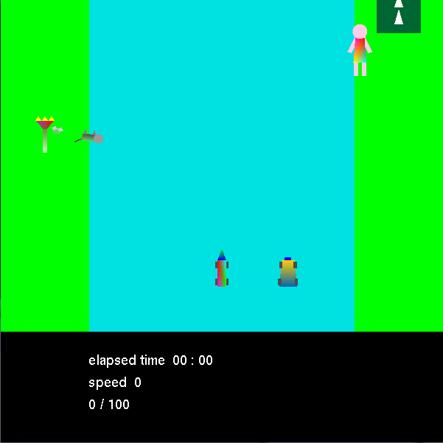
Squash Game

Slide 6
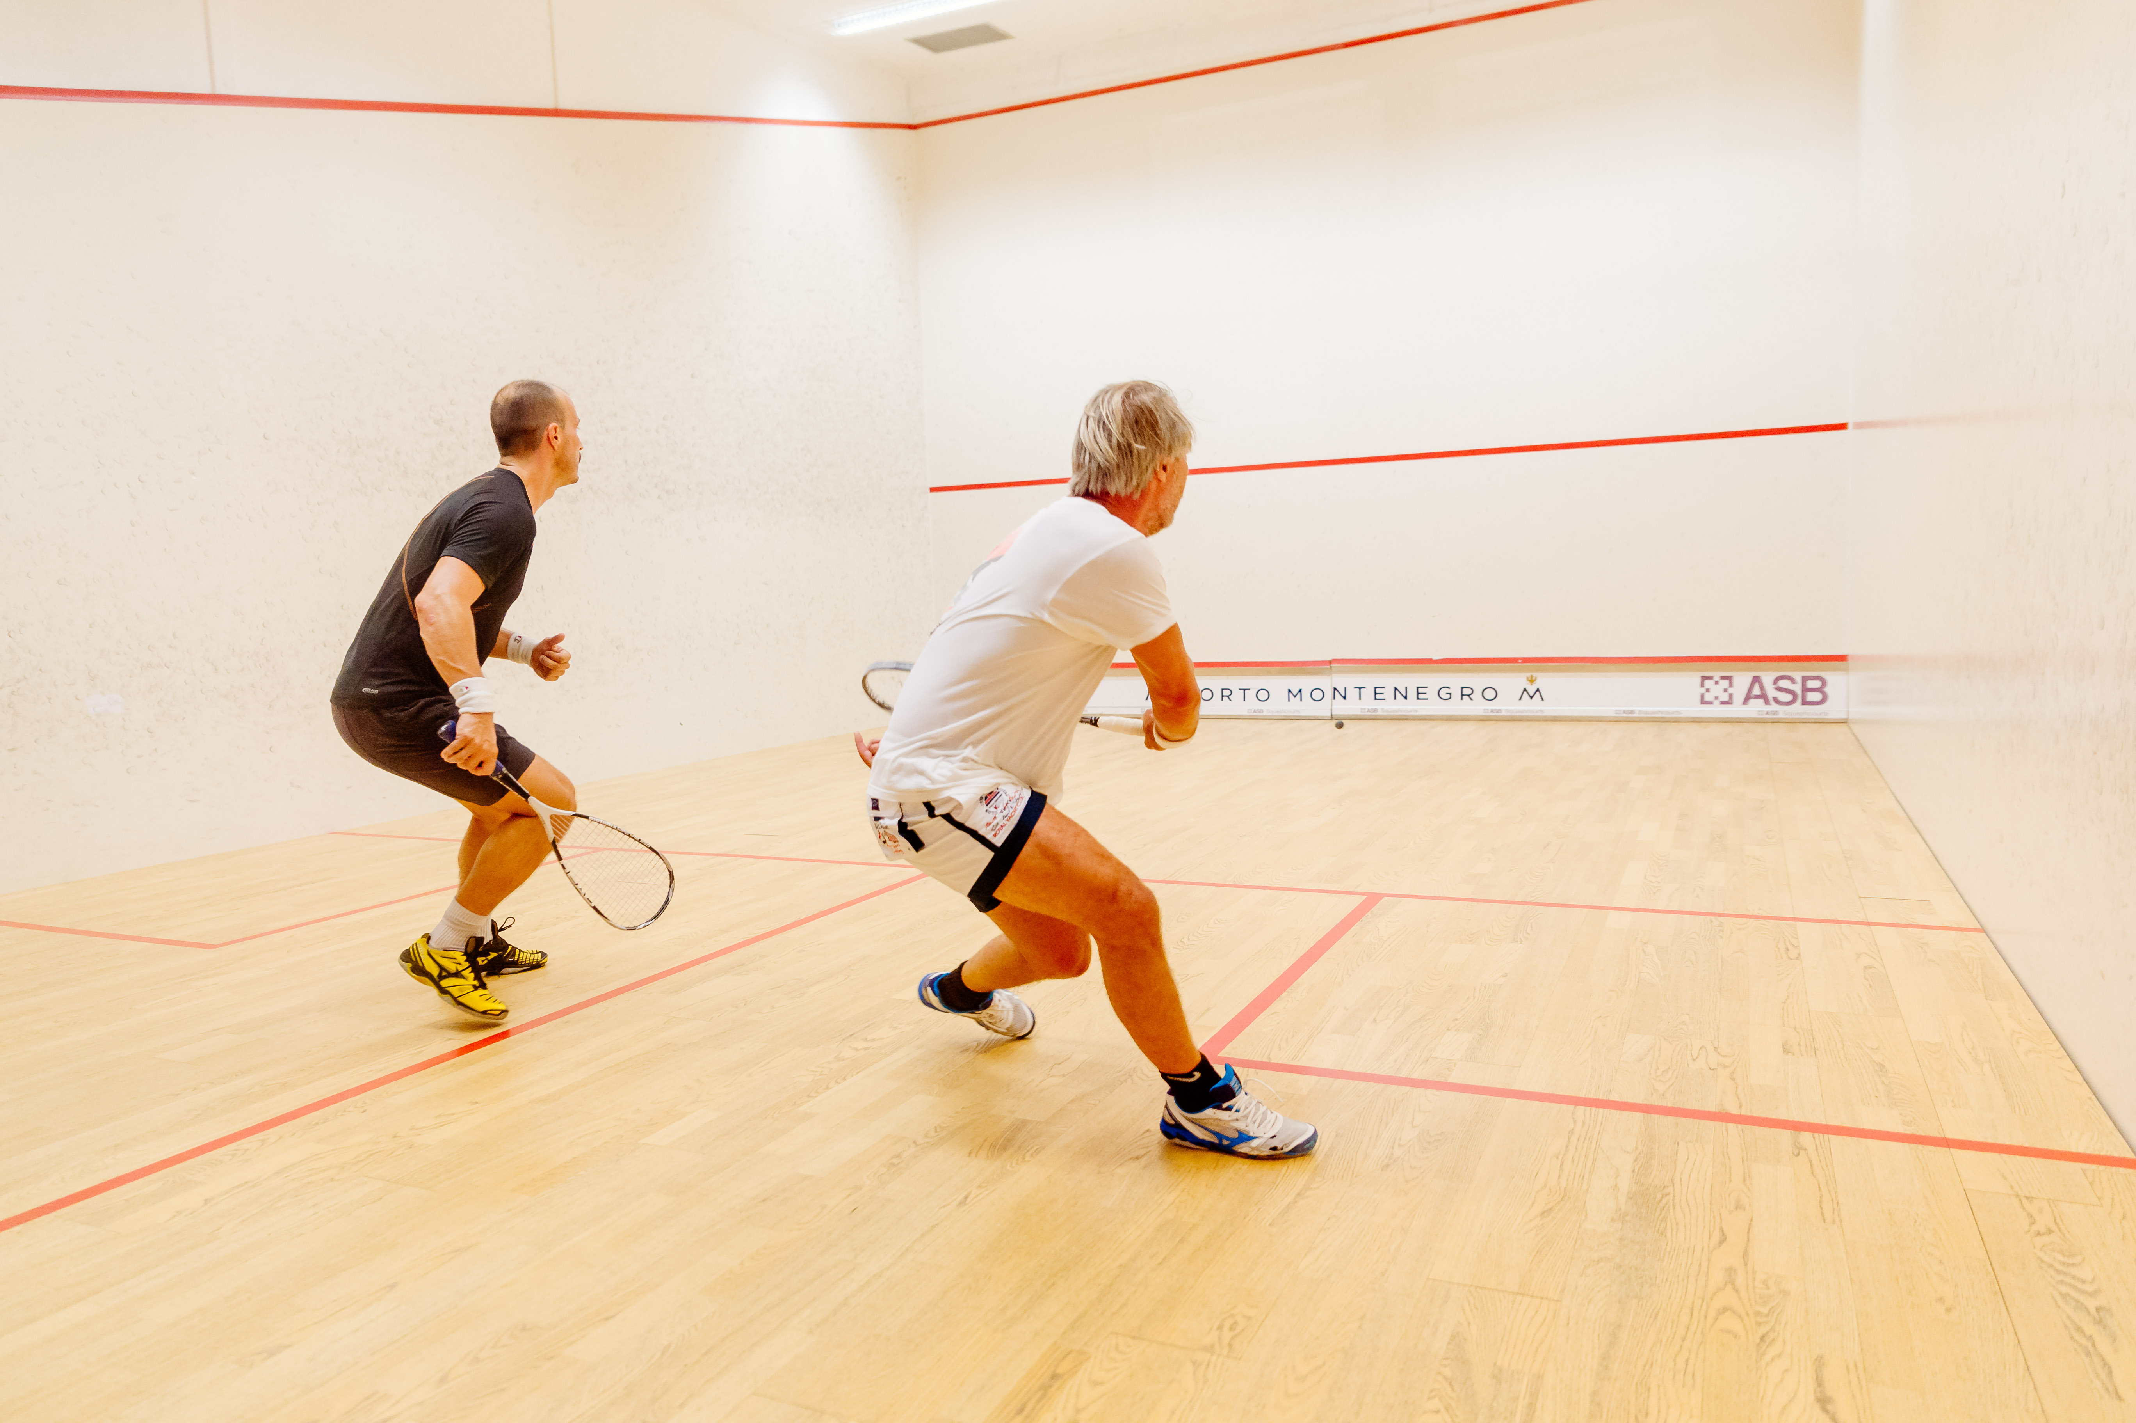
Squash Game

Slide 7
Squash Game

Slide 8
6
Squash Game
Use GlutIdleFunc
X -> -8 ~ 8 ~ -8
Y -> -6 ~ 6 ~ -6
Z -> 0 ~ -7 ~ 0
-6
-7
-8
8
0

Slide 9
6
Squash Game
Other Features
Time check
Stage level
Irregular Bounce
Fog effect
Sound Effect
-6
-7
-8
8
0

Slide 10
Squash Game
Code
Idea
Demo
Q&A

Slide 11
Squash Game
Code

Slide 12
Movement of the ball
Squash Game
Speed : xMax, yMax, zMax
Coordinate : _xSpeed, _ySpeed, zSpeed
_xSpeed
0
~
xMax / 2
~
xMax
-8
~
0
~
-8

Slide 13
Squash Game
Code
Idea
Demo
Q&A

Slide 14
Squash Game
Demo

Slide 15
Squash Game
Code
Idea
Demo
Q&A

Slide 16
Squash Game
Question &
Answer
Q&A

Slide 17
THANK YOU

